Slide 1
Unpacking the Black Box
How to Interpret your Machine Learning Model

Slide 2


About us
Marysia Winkels
James Hayward
Data Science Educator @ GoDataDriven
Data Science Educator @ GoDataDriven
Notes:
Introduce ourselves
Background James. & Marysia
Work at GoDataDriven
Artificial Intelligence at the University of Amsterdam with a focus on Geometric Deep Learning
Worked as a machine learning engineer in the deep learning for medical images space
Nowadays I’m a data science educator at GoDataDriven
In addition to that, I’m the chair for PyData Amsterdam and PyData Global – for which the proceeds are used to support open source projects in scientific computing

Slide 3
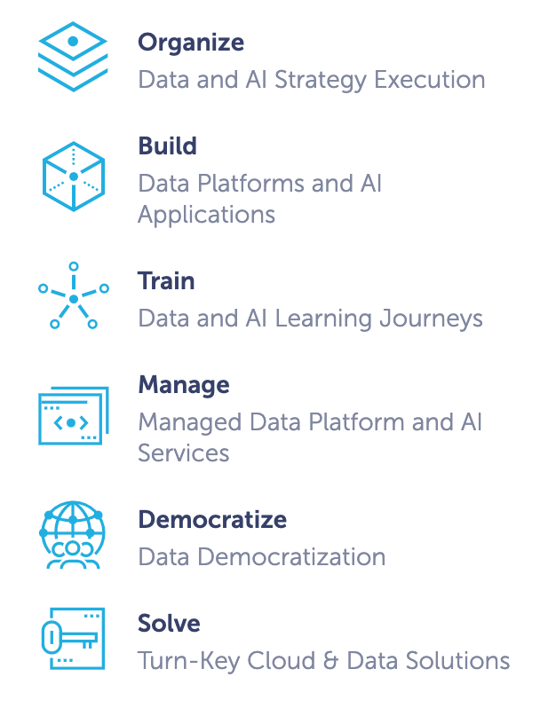
GoDataDriven
Notes:
As said, we both work for GoDataDriven, which is a Dutch Data Science consultancy based in Amsterdam.

Slide 4

Notes:
GoDataDriven has been helping businesses become data driven and get value from their data since 2009.
In addition to consultancy projects, one way we do that is through our public and in-company trainings.

Slide 5
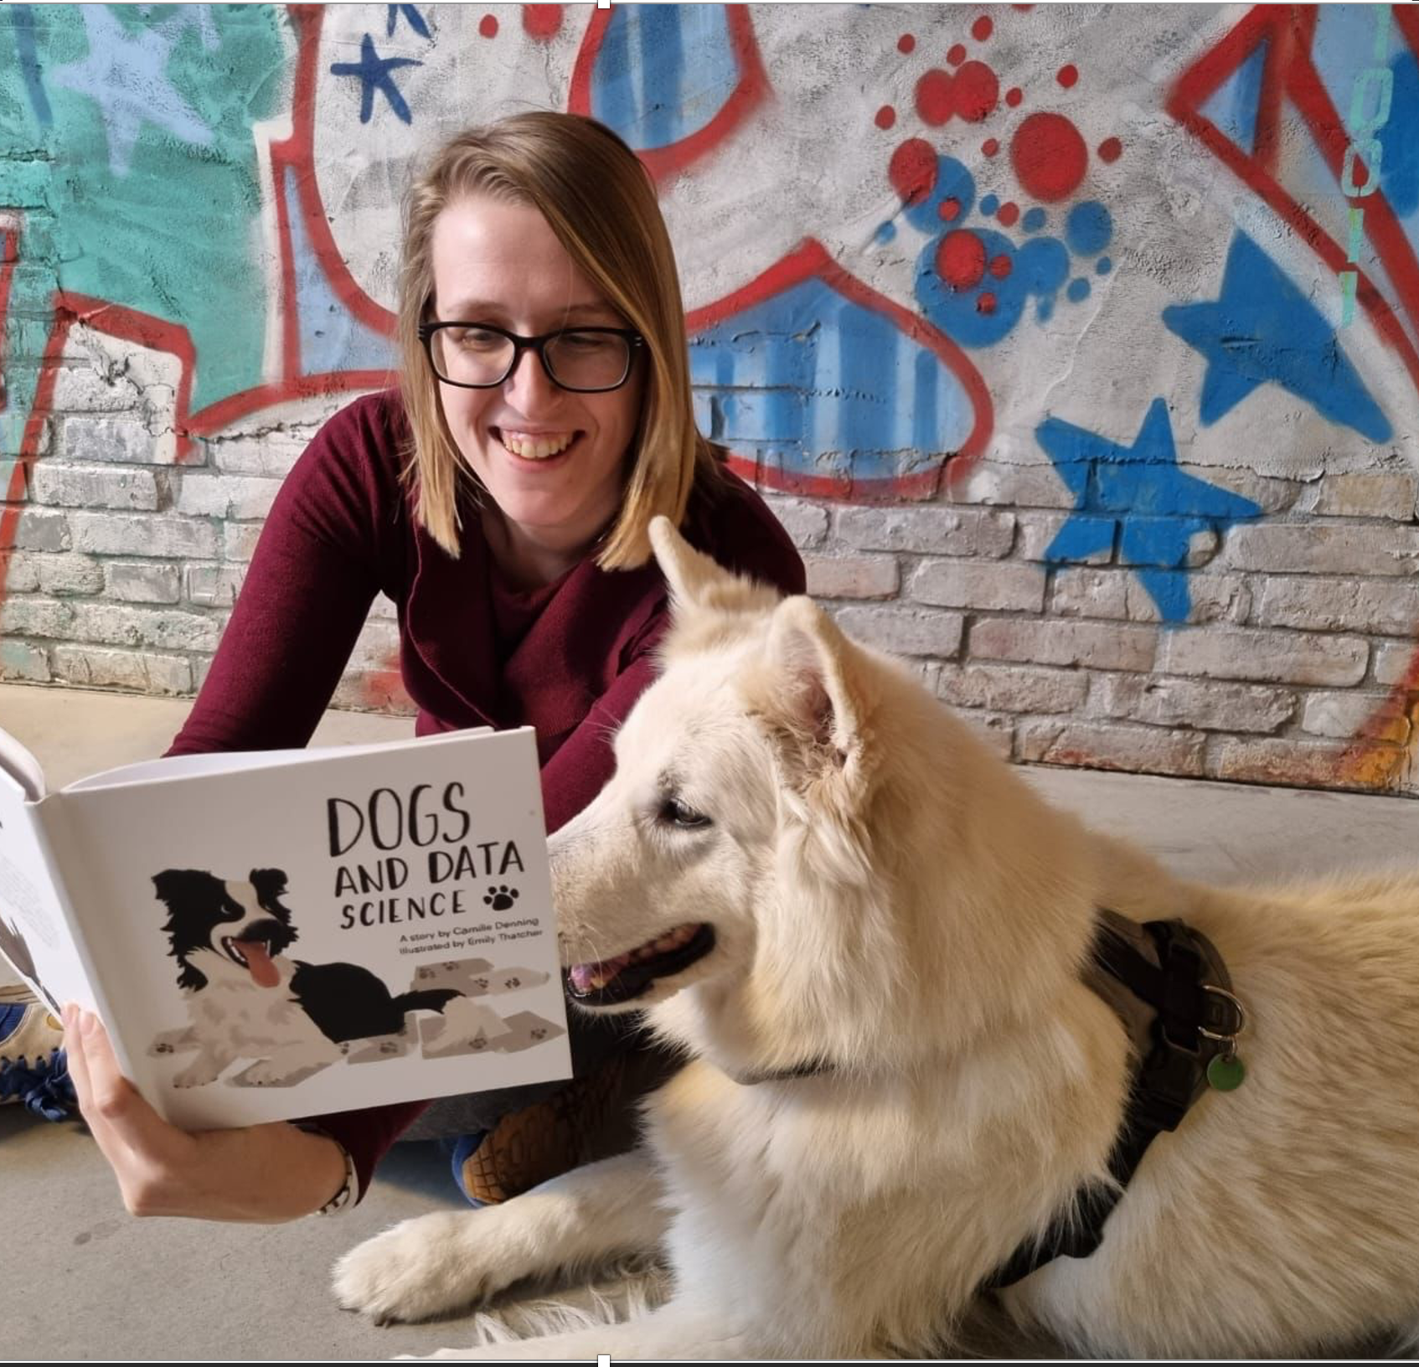
GoDataDriven Academy
A variety of courses
Data Science with Python (introductory & advanced)
Deep Learning
Data Visualisation & Storytelling
Analytics Translation
Time Series
Machine Learning Explainability
Notes:
We’re Data Science Educators!

Slide 6

About you!
Join us at PollEverywhere
gdd.li/poll-amld

Slide 7

Workshop outline
Topics are covered in the following way:
Experiment first
Explain later
Put it in practice:
Hackathon
Lightning talks!
Notes:
Our goal is to inspire
Experiment
Explain MENTION WORKING TOGETHER

Slide 8


Workshop content
What we will cover:
What this workshop is not about:
Intrinsicly explainable machine learning models
Methods for model-agnostic interpretability
Advantages and disadvantages of each method
The theory behind every machine learning model (algorithmic transparency)
Shapley values
Neural networks

Slide 9


Material
Two ways to access the material:
gdd.li/github
Binder Does not require any installation
Download or clone the material from our GitHub repository
gdd.li/binder

Slide 10
Unpacking the black box
Notes:
This section should contain:
History, definition and why of interpretability
Example based algorithms

Slide 11
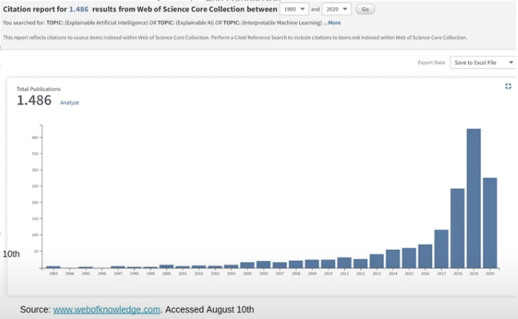
History
1800s – Linear Regression
1960s – Decision Tree
2001 – Random Forests
2012 – Deep Learning
2016 – Interpretable Machine Learning

Slide 12
“Interpretability is the degree to which a human can understand the cause of a decision”
Source: Miller, Tim. "Explanation in artificial intelligence: Insights from the social sciences.
Notes:
Humans usually do not ask why a certain prediction was made, but why this prediction was made instead of another prediction. We tend to think in counterfactual cases, i.e. “How would the prediction have been if input X had been different?”.
Explainability / interpretability
Explanations are selected. People do not expect explanations that cover the actual and complete list of causes of an event. We are used to selecting one or two causes from a variety of possible causes as THE explanation.
For machine learning models, it is advantageous if a good prediction can be made from different features. Ensemble methods that combine multiple models with different features (different explanations) usually perform well because averaging over those “stories” makes the predictions more robust and accurate. But it also means that there is more than one selective explanation why a certain prediction was made. What it means for interpretable machine learning: Make the explanation very short, give only 1 to 3 reasons, even if the world is more complex.

Slide 13
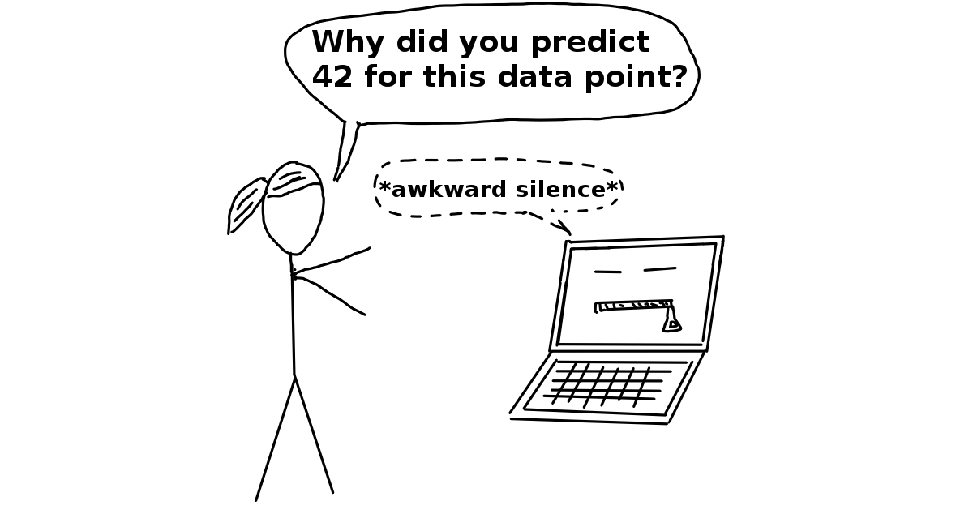
Why of Interpretability
Source: Interpretable Machine Learning – Christopher Molnar

Slide 14
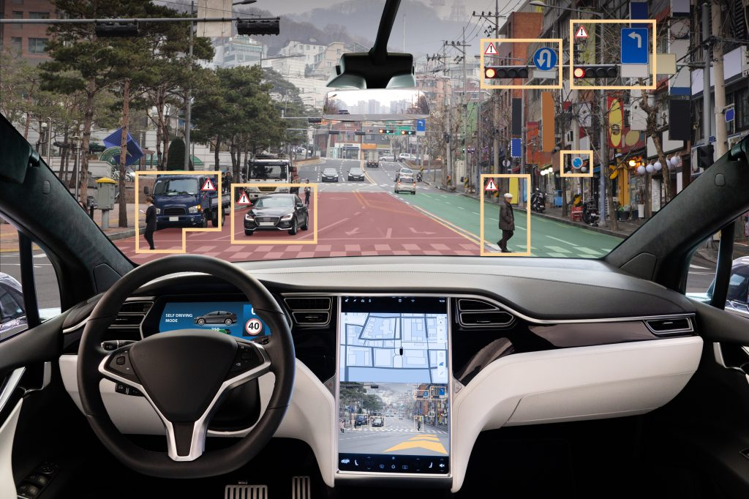
Why of Interpretability
Engender trust
Notes:
Machine learning models take on real-world tasks that require safety measures and testing. Imagine a self-driving car automatically detects cyclists based on a deep learning system. You want to be 100% sure that the abstraction the system has learned is error-free, because running over cyclists is quite bad. An explanation might reveal that the most important learned feature is to recognize the two wheels of a bicycle, and this explanation helps you think about edge cases like bicycles with side bags that partially cover the wheels.

Slide 15
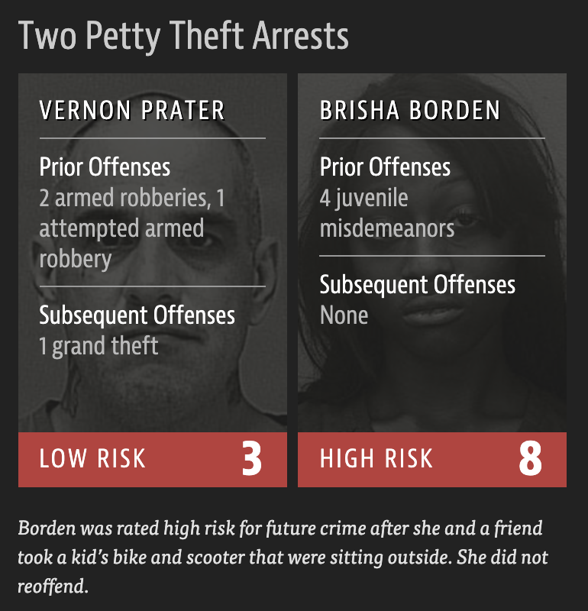
Why of Interpretability
Engender trust
Right to explanation
Source:
https://www.propublica.org/article/machine-bias-risk-assessments-in-criminal-sentencing

Slide 16
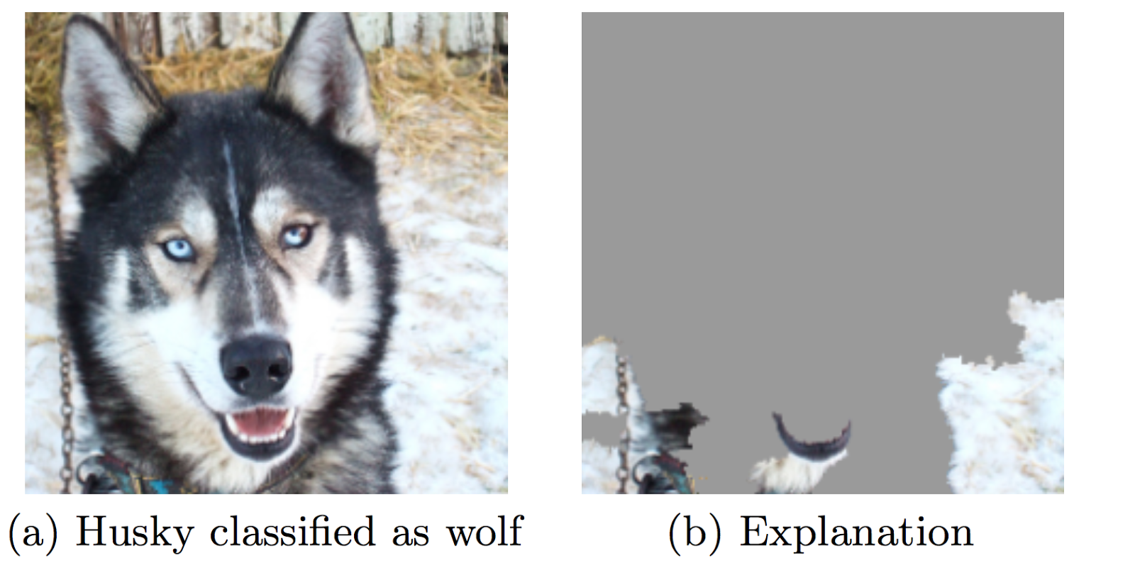
Why of Interpretability
Engender trust
Right to explanation
Debug models
Notes:
Machine learning models can only be debugged and audited when they can be interpreted. Even in low risk environments, such as movie recommendations, the ability to interpret is valuable in the research and development phase as well as after deployment. Later, when a model is used in a product, things can go wrong. An interpretation for an erroneous prediction helps to understand the cause of the error. It delivers a direction for how to fix the system. Consider an example of a husky versus wolf classifier that misclassifies some huskies as wolves. Using interpretable machine learning methods, you would find that the misclassification was due to the snow on the image. The classifier learned to use snow as a feature for classifying images as “wolf”, which might make sense in terms of separating wolves from huskies in the training dataset, but not in real-world use.

Slide 17
“Thing B is similar to thing A, and thing A caused Y, so I predict that B will cause Y!”

Slide 18
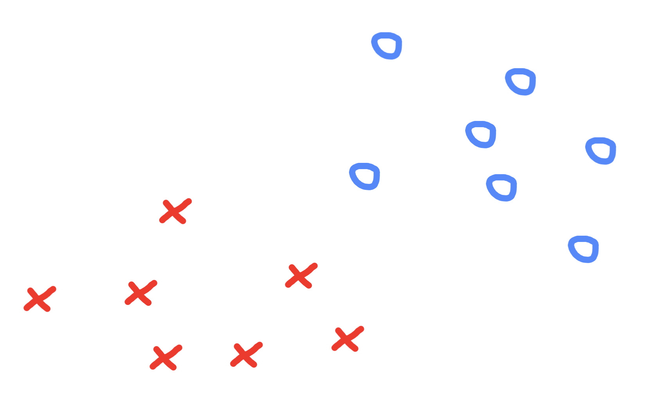
Example-based explanations
Some dataset with two classes
Notes:
Example-based explanation methods select particular instances of the dataset to explain the behavior of machine learning models or to explain the underlying data distribution.
Example-based explanations are mostly model-agnostic, because they make any machine learning model more interpretable. The difference to model-agnostic methods is that the example-based methods explain a model by selecting instances of the dataset and not by creating summaries of features (such as feature importance or partial dependence).
The following interpretation methods are all example-based:
Counterfactual explanations tell us how an instance has to change to significantly change its prediction. By creating counterfactual instances, we learn about how the model makes its predictions and can explain individual predictions.
Adversarial examples are counterfactuals used to fool machine learning models. The emphasis is on flipping the prediction and not explaining it.
Prototypes are a selection of representative instances from the data and criticisms are instances that are not well represented by those prototypes. ²⁹
Influential instances are the training data points that were the most influential for the parameters of a prediction model or the predictions themselves. Identifying and analysing influential instances helps to find problems with the data, debug the model and understand the model’s behavior better.
k-nearest neighbors model: An (interpretable) machine learning model based on examples.

Slide 19
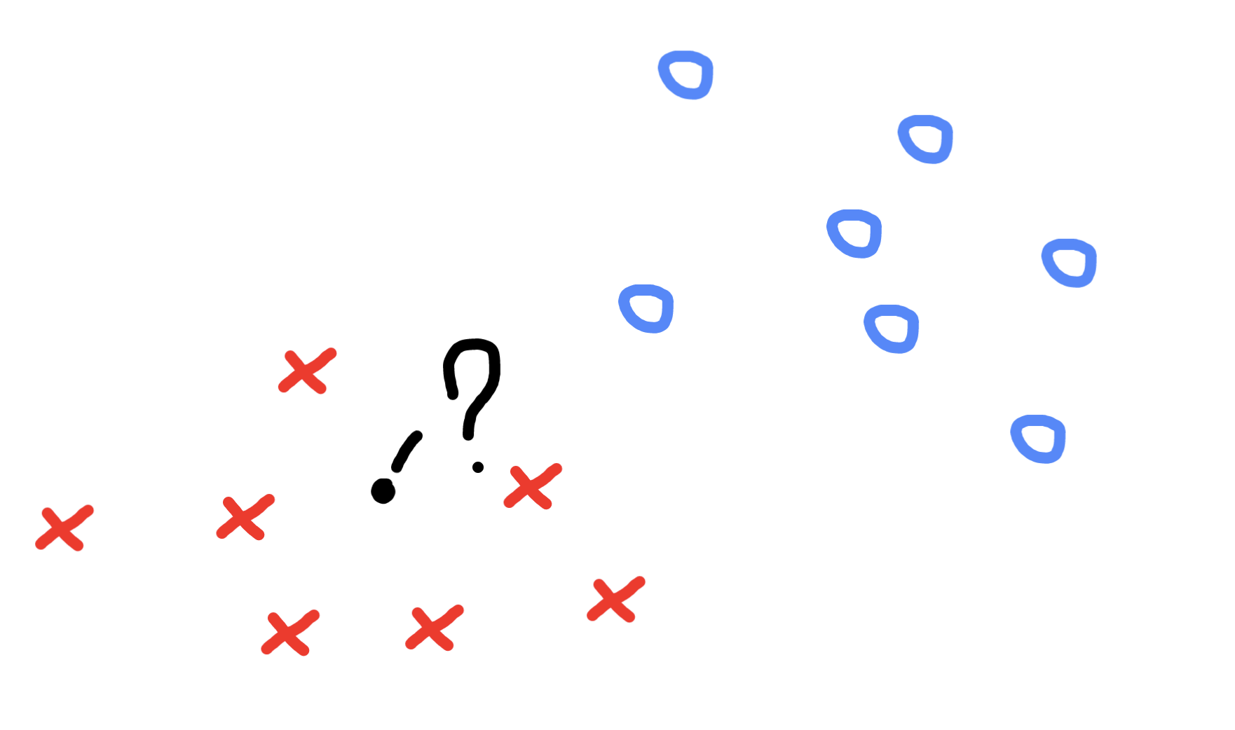
Example-based explanations
Some dataset with two classes
A new data point to classify
Notes:
The following interpretation methods are all example-based:
Counterfactual explanations tell us how an instance has to change to significantly change its prediction. By creating counterfactual instances, we learn about how the model makes its predictions and can explain individual predictions.
Adversarial examples are counterfactuals used to fool machine learning models. The emphasis is on flipping the prediction and not explaining it.
Prototypes are a selection of representative instances from the data and criticisms are instances that are not well represented by those prototypes. ²⁹
Influential instances are the training data points that were the most influential for the parameters of a prediction model or the predictions themselves. Identifying and analysing influential instances helps to find problems with the data, debug the model and understand the model’s behavior better.
k-nearest neighbors model: An (interpretable) machine learning model based on examples.

Slide 20
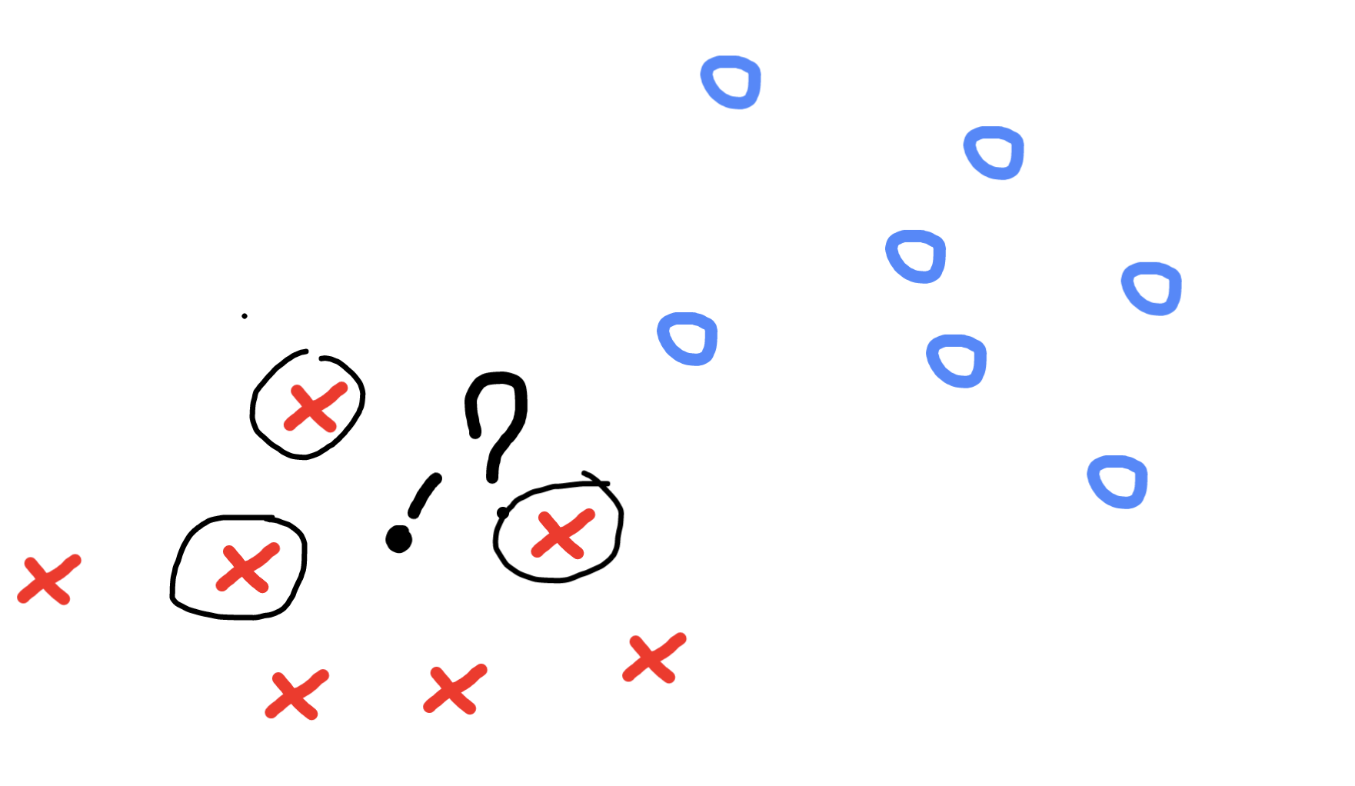
Example-based explanations
Some dataset with two classes
A new data point to classify
An explanation based on nearby data points
Notes:
The following interpretation methods are all example-based:
Counterfactual explanations tell us how an instance has to change to significantly change its prediction. By creating counterfactual instances, we learn about how the model makes its predictions and can explain individual predictions.
Adversarial examples are counterfactuals used to fool machine learning models. The emphasis is on flipping the prediction and not explaining it.
Prototypes are a selection of representative instances from the data and criticisms are instances that are not well represented by those prototypes. ²⁹
Influential instances are the training data points that were the most influential for the parameters of a prediction model or the predictions themselves. Identifying and analysing influential instances helps to find problems with the data, debug the model and understand the model’s behavior better.
k-nearest neighbors model: An (interpretable) machine learning model based on examples.

Slide 21
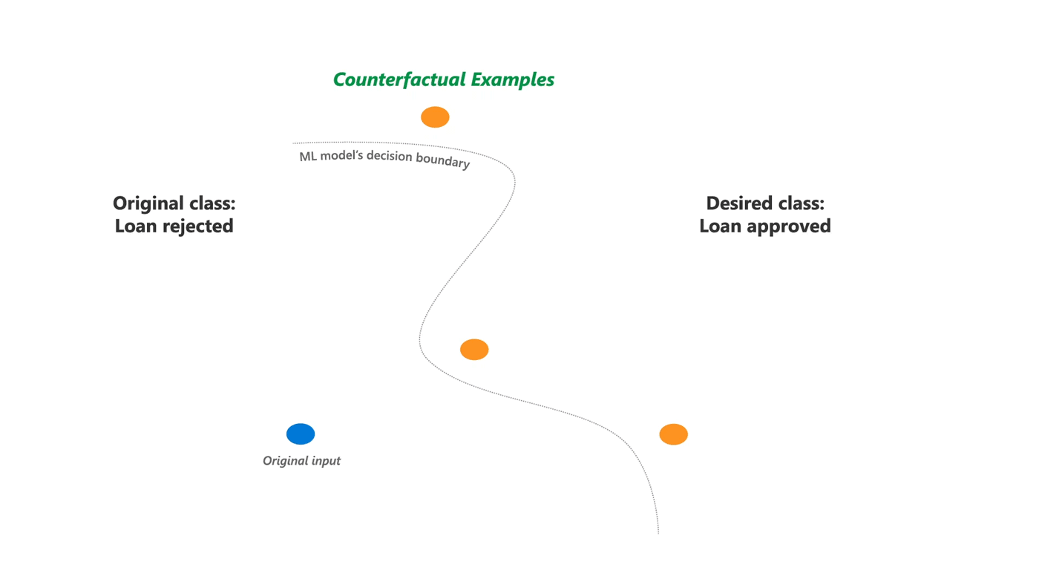
Example-based explanations
Some models
Counterfactual explanations
Adversarial examples
Prototypes & Criticisms
Influential instances
Notes:
The following interpretation methods are all example-based:
Counterfactual explanations tell us how an instance has to change to significantly change its prediction. By creating counterfactual instances, we learn about how the model makes its predictions and can explain individual predictions.
Adversarial examples are counterfactuals used to fool machine learning models. The emphasis is on flipping the prediction and not explaining it.
Prototypes are a selection of representative instances from the data and criticisms are instances that are not well represented by those prototypes. ²⁹
Influential instances are the training data points that were the most influential for the parameters of a prediction model or the predictions themselves. Identifying and analysing influential instances helps to find problems with the data, debug the model and understand the model’s behavior better.
k-nearest neighbors model: An (interpretable) machine learning model based on examples.

Slide 22
Jupyter Notebook 1 01_Introduction.ipynb

Slide 23
The inherent interpretability of ML models
Notes:
In the previous exercise we were trying to classify species of penguins based on measurements of their flipper length and body mass.

Slide 24
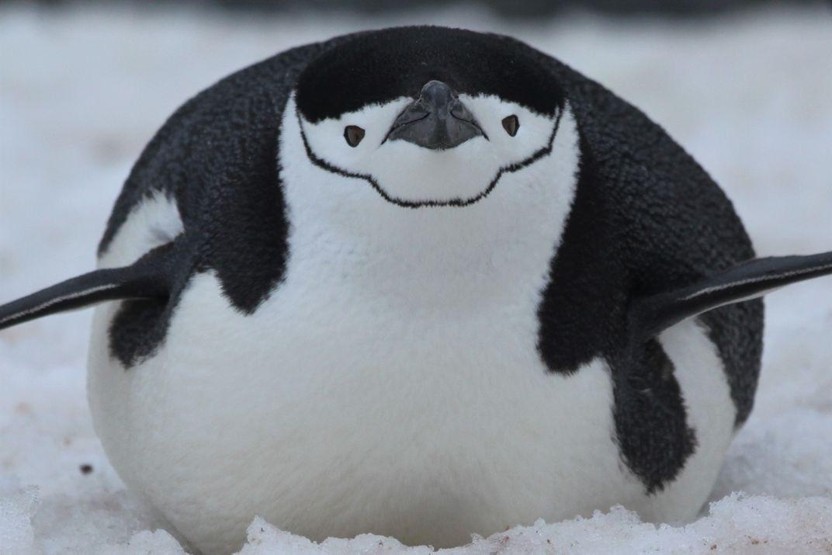
Penguin 218
MISCLASSIFED AS GENTOO
Species: Chinstrap
Flipper length: 210mm
Body mass: 4100g
Notes:
Whilst the models we trained generally performed well, they occasionally misclassified some penguins.
For example, the Decision Tree misclassified a Chinstrap penguin
Neverthelss, after analysing the model we trained, we were able to establish which feature values should be altered in order to change the prediction outcome. Otherwise known as “flipping the prediction” or counterfactuals.
For this Chinstrap penguin, if it had a slightly lower body mass it would not have been misclassified.
This level of explainability is useful when you are dealing with cases on an individual level.
For example, explaining to a customer why they did not qualify for a loan or what they would need to change.

Slide 25
Inherent model interpretability
Decision Tree
Gradient Boosting
Support Vector Machine
Linear Regression
Neural Networks
Easy
Difficult
Interpretability
Notes:
However, we also saw that it was easier to “flip the prediction” for the Decision Tree than it was for the SVM. This is due to the inherent nature of the models.
In this section we shall detail how several Machine Learning models work, so as to explain why some models are naturally more interpretable than others.

Slide 26
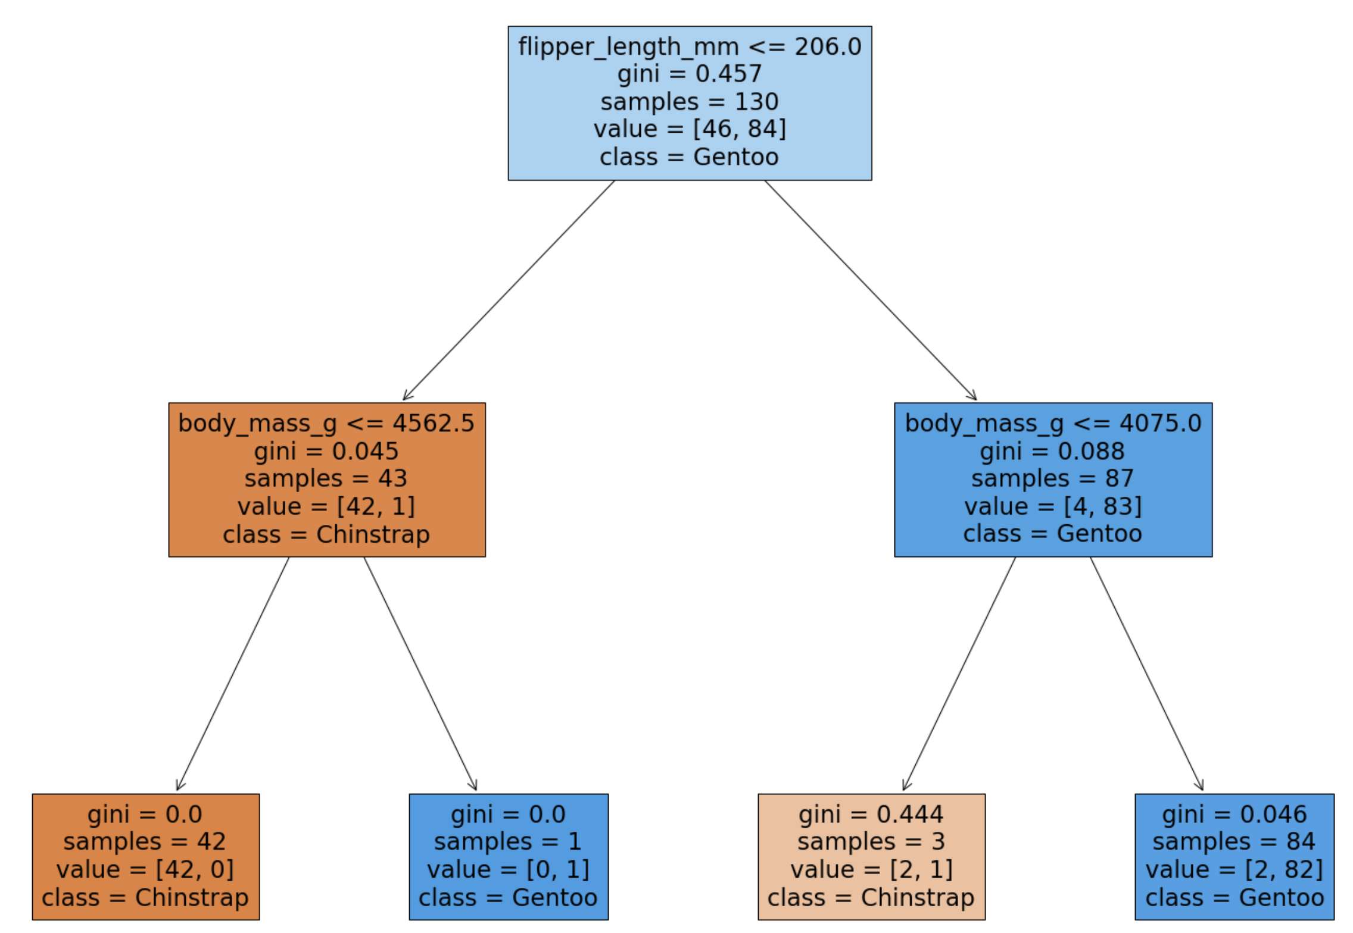
The inherent interpretability of ML models
Decision Tree Classifer
Notes:
We shall start with the Decision tree

Slide 27
Decision Tree Classifer
Notes:
We can see on the screen the Decision Tree that we learnt earlier.
We were able to use it to make predictions about penguin species, but how did we result in this specific tree?
Let’s take a closer look.

Slide 28
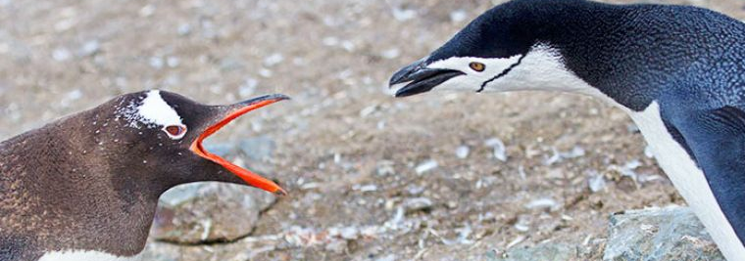
Decision Tree Classifer
46
Chinstrap
84
Gentoo
Notes:
Now, in our training set there were 84 Gentoo penguins and 46 Chinstrap
If you were not given any more information about the penguins and asked to guess what species a new penguin is going to be, which would you choose?

Slide 29
Decision Tree Classifer
Notes:
This is exactly what happens at the first level of the decision tree! Let’s take a closer look at the root of the tree.

Slide 30
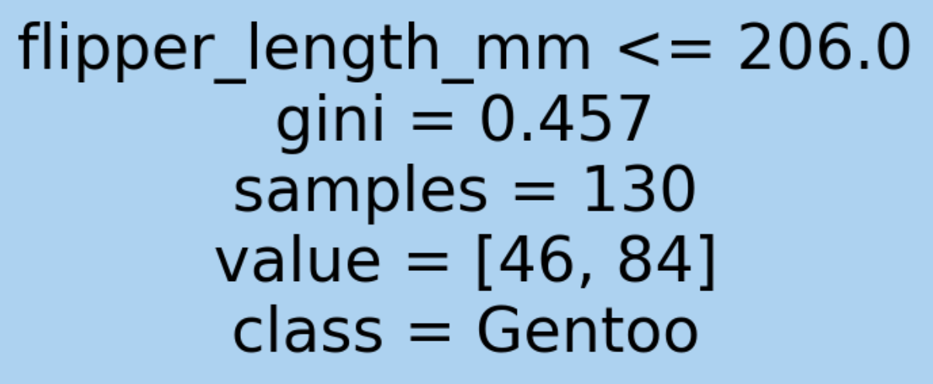

Decision Tree Classifer
gini = $1 −{\frac{46}{130}}^{2}− {\frac{84}{130}}^{2}$= 0.457…
Notes:
Before it is allowed to make any decisions, the decision tree automatically classifies all penguins as Gentoos because they are the majority class!
Of course, some of the penguins will get misclassified in this scenario (46 Chinstraps). Thefore this node is considered “impure”
The impurity can be quantified by calculating the gini impurity which is shown here.
Note, we are describing a CART decision tree as it is learnt usinng gini impurity.
ID3 is another type of decision tree that is learnt using information gain (based on entropy): Developed around the same time - numerically they are quite similar and gini is typically the most commonly used.

Slide 31
Decision Tree Classifer
Notes:
Ideally, we want to reduce the gini impurity to be 0, which is what we manage to achieve in some of the leaves.
For example, if a penguin has a flipper length less than 206 & body mass less than 4562.5, it ends up in this leaf.

Slide 32
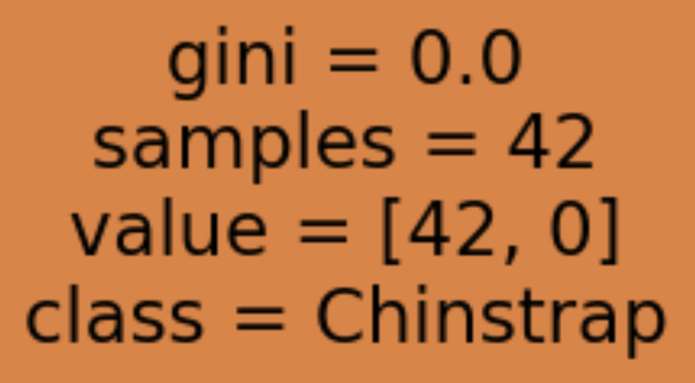
Decision Tree Classifer
gini = $1 −{\frac{42}{42}}^{2}− {\frac{0}{42}}^{2}$= 1 – 1 – 0 = 1
Notes:
We can see that 42 penguins from the training set fit this description.
They are all Chinstrapp so we have a Gini impurity of 0.

Slide 33
Decision Tree Classifer
Notes:
iI a penguin has a flipper length greater than 206 & body mass greater than 4075 it ends up in this leaf.

Slide 34
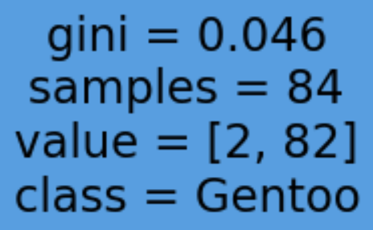
Decision Tree Classifer
gini = $1 −{\frac{2}{84}}^{2}− {\frac{82}{84}}^{2}$= 0.046
Notes:
We can see that 84 penguins from the training set fit this description.
They majority our Gentoo, however there is small minority that is Chinstrap, which is why the gini impurity is not zero

Slide 35
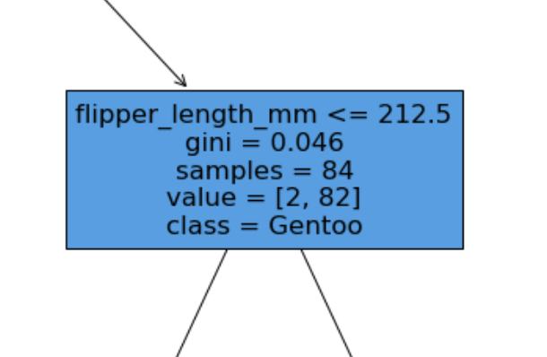
Decision Tree Classifer
?
?
Notes:
If we take another decision level, it may be the case that we can separate Chinstrap & Gentoo.
However, if our decision tree becomes too big it may become to specific to the actual dataset, instead of learning the problem at hand. If this happens we say the model has overfit on the dataset.
For example, the two Chinstrap penguins here largely fit the description of Gentoos so they may be anomalies. In this scenario we would not want to encode information about them into our model.
Fortunately overfitting can be tested for, but it is beyond the scope of this session.

Slide 36
Decision Tree Classifer
Notes:
So, now we know we want to reduce the gini impurity of the nodes in our decision tree,
(with a caveat that we want to avoid the ree becoming too large).
But how we do that… well the clue is in the name, we make decisions!

Slide 37


Decision Tree Classifer
$0.045 ×{\frac{43}{130}}^{}+0.088 ×{\frac{87}{130}}^{}$= 0.074
Notes:
The first decision it makes is about whether the flipper length is less than or equal to 206.
However, we could have had a decision about:
Whether the flipper length is less than or equal to 207
Or even a decision about the body mass.
So why are we did we choose this one? Because this resulted in the lowest total gini impurity at the next level!
In orange: 42 of one class, 1 of the other, impurity of 0.045
In blue: 4 of one class, 83 of the other, impurity of 0.088
So we have a proportional total impurity of 0.074.
The decision tree algorithm searches all the features (flipper length and body mass) and the possible values and selects the decision which results in the lowest total gini impurity at the next level (if there are ties, one can be chosen at random).

Slide 38
Penguin 218
Flipper length: 210mm
Body mass: 4100g
Predict Gentoo
Notes:
Ultimately, the decision tree results in a set of rules which we can use to perform classification.
So, we are able to explain exactly why we made our predictions

Slide 39
Penguin 218
Flipper length: 210mm
Body mass: 4070g
Predict Chinstrap
Notes:
And also what would happen if a value was different.

Slide 40
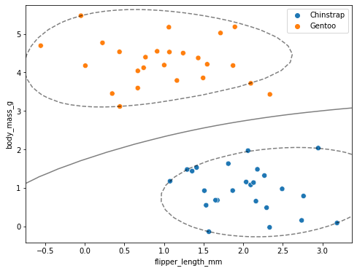
The inherent interpretability of ML models
Support Vector Machine Classifer
Notes:
We started with the Decision tree, we shall now look at the SVM.

Slide 41
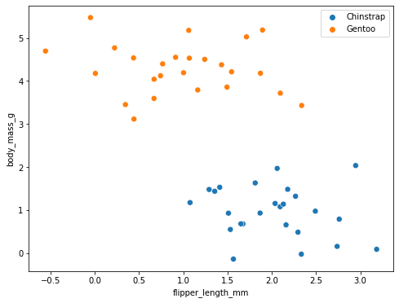
Support Vector Machine Classifier
Notes:
We also looked at the Support Vector Machine Classifier
In contrast to the decision tree, which produces a set of rules that we can use for classification, the support vector machine algorithm attempts to find a line or curve that can separate the data classes.

Slide 42
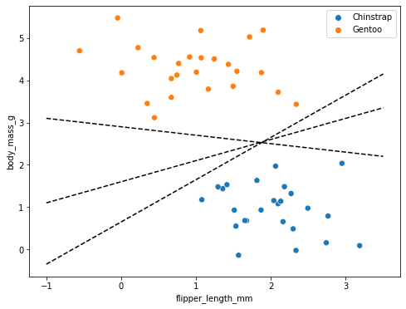
Support Vector Machine Classifier
Notes:
However, this example illustrates a problem, there are a few ways to separate the data.
Depending on which one you choose, a new data point (e.g. this start) will be assigned to a differrent class.

Slide 43
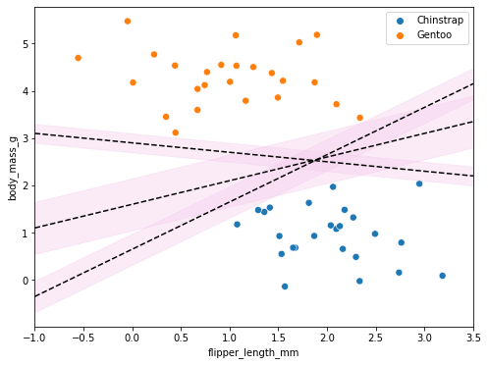
Support Vector Machine Classifier
Notes:
The SVM determines the optimal separation as the one with the biggest margin between points of different classes

Slide 44
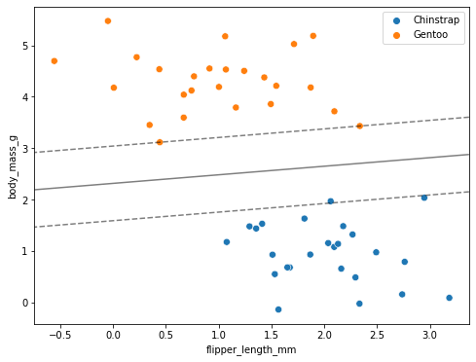
Support Vector Machine Classifier
Notes:
We can then use this separation boundary to perform classification.
For this example, it is easy to explain why we made our predictions and also what would happen if a vfeature value was different.
(The points on the line are known as support vectors).

Slide 45
Support Vector Machine Classifier
Notes:
However, it is not always optimal to use a linear separation boundary.
In this scenario, it would not be as simple to determine how much feature values need to be altered in order to change the prediction outcome (flip the prediction).
(This example also uses a soft margin: points can be permitted to creep beyond the margin if it allows for a better fit. The optimal level of “softness” can be a tunable parameter.)

Slide 46
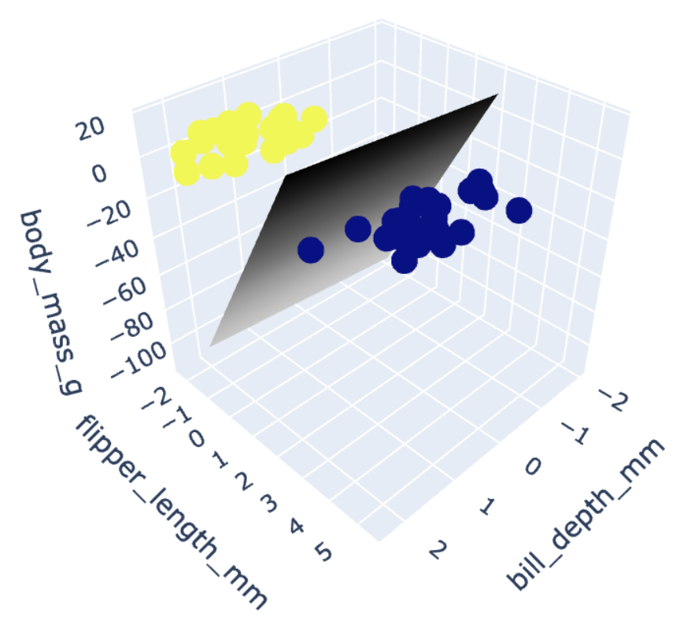
Support Vector Machine Classifier
Notes:
In the case where there are three features, the decision boundary is a plane.
Again, in this scenario, it would not be as simple to determine how much feature values need to be altered in order to change the prediction outcome (flip the prediction).
Obviously this issue will be compounded by the more features we add – and with four or more features, visualisations will become impossible!

Slide 47
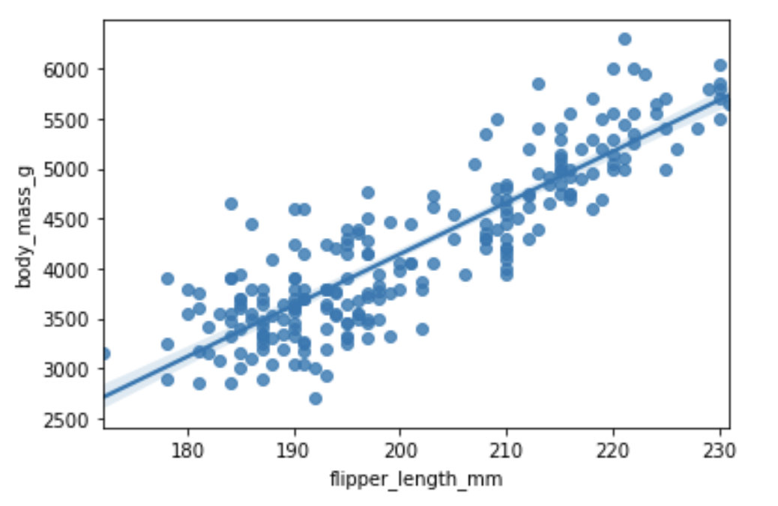
The inherent interpretability of ML models
Linear Regression
Notes:
Having looked at two classifiers, we will now look at a regression model.

Slide 48
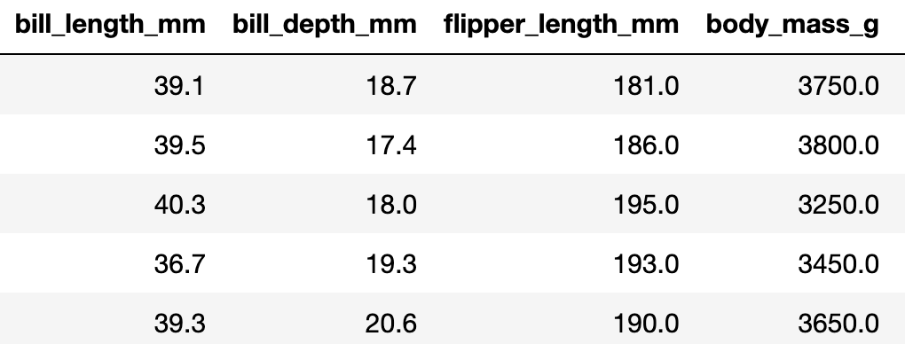
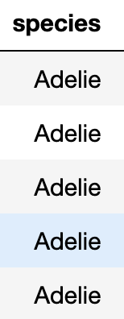
Classification
Notes:
So far we have focussed on classification, where we try to predict the class or category a data instance belongs to.

Slide 49
Regression
Notes:
Classification is not the only machine learning task we can perform.
With regression, we aim to predict a continuous numeric quantity.

Slide 50
Linear Regression
m*bill depth + n*flipper length + c = body mass
Notes:
A simple but common approach for solving problems like this is to learn a linear regression model.
In the context of this example it would mean learning a formula to predict body mass based on bill depth and flipper length (where m, n & c have to be learnt from the data).

Slide 51
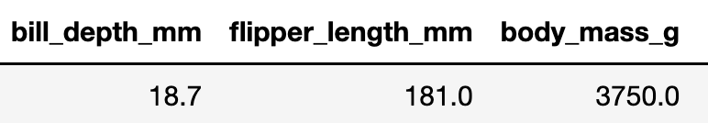
Linear Regression
m*bill depth + n*flipper length + c = body mass
14*bill depth + 53*flipper length - 6600 = body mass
14*18.7+ 53*181.0 - 6600 = 3171
Notes:
I learnt the following model to predict body mass, based on bill depth and flipper length, by running linear regression on the Penguins dataset.
With this linear regression model it is easy to explain our predictions.
For this penguin which has bill depth 18.7 and flipper length of 181, it predicts a body mass of 3171 – a reasonable prediction.
It is also easy to show what would happen if a value was different
The “m” and “n” values are called coeffecicients. If the flipper length were to increase by one unit (e.g. got from 181 to 182) the prediction for body mass would increase by 53.
The ”c” value is called the intercept, it indicates what the prediction would be if the other features were zero. In this case it is nonsensical, if bill depth and flipper length were zero than the body mass would be -6600g. However, we are extrapolating beyond the bounds of our data: the minimum bill depth is 13.2 mm and the minimum flipper length is 172 mm.

Slide 52
Model-agnostic interpretability methods
Notes:
In the previous exercise we were trying to classify species of penguins based on measurements of their flipper length and body mass.

Slide 53
Jupyter Notebook 2 02_Ceteris_Paribus_Plots.ipynb

Slide 54
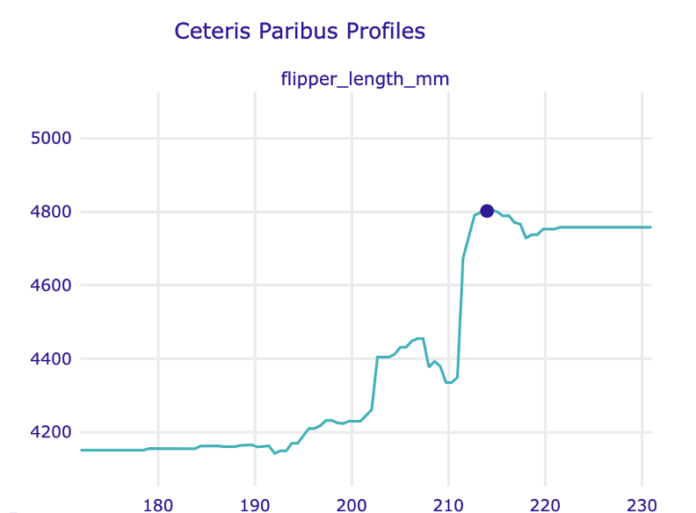
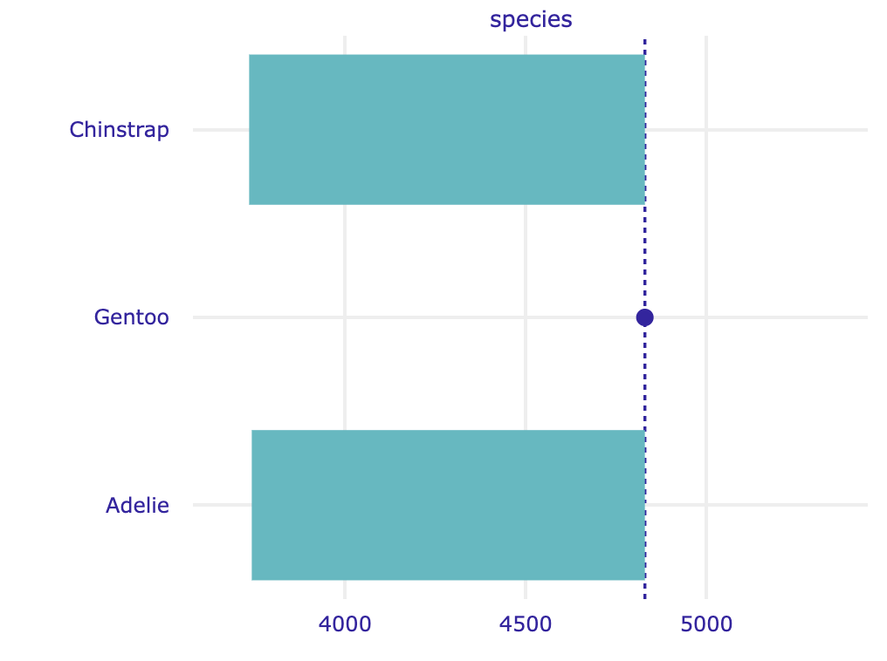
Ceteris Paribus profile
Numerical and categorical features
Numerical features
Categorical features
Notes:
This section should explain ceteris paribus plots and answer the questions from the assignment
Is it the same for every model? Is it the same for every data point?

Slide 55
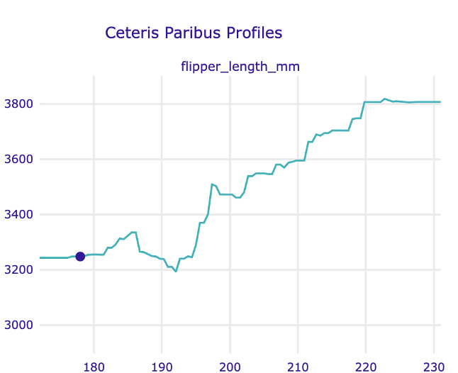
Ceteris Paribus profile
Different plots for different data points
Row 231: A Gentoo penguin
Row 30: An Adélie penguin
Notes:
This section should explain ceteris paribus plots and answer the questions from the assignment
Is it the same for every model? Is it the same for every data point?

Slide 56
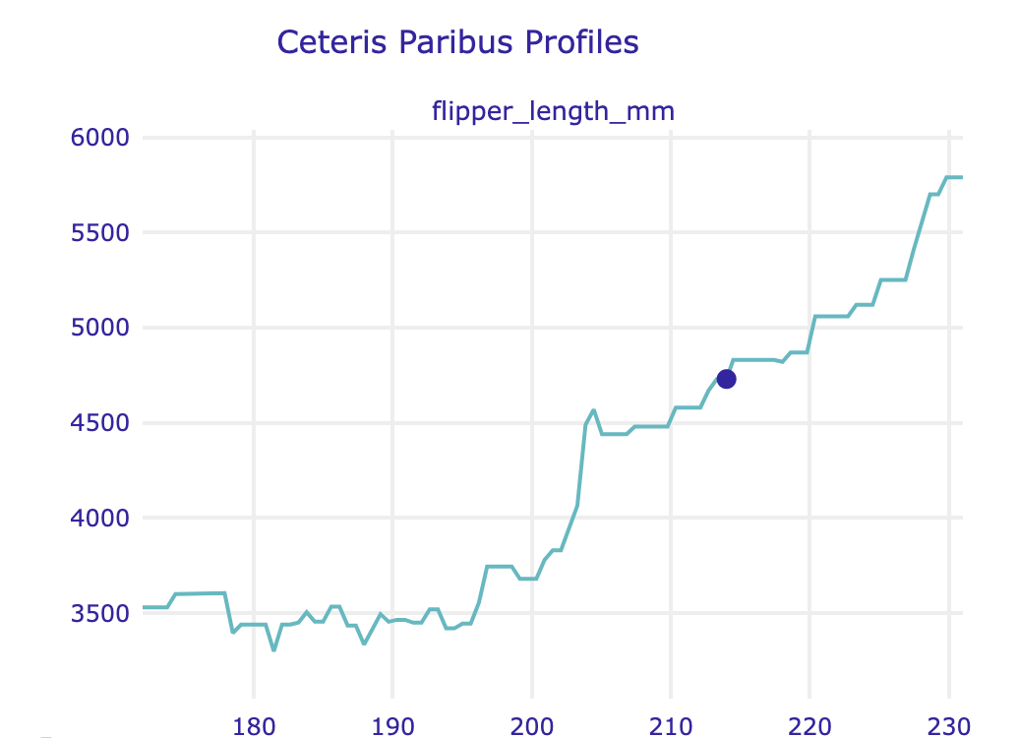
Ceteris Paribus profile
Different plots for different models
Row 231: A Gentoo penguin
Random Forest Regressor
Row 231: A Gentoo penguin
K-Nearest Neighbors Regressor
Notes:
This section should explain ceteris paribus plots and answer the questions from the assignment
Is it the same for every model? Is it the same for every data point?

Slide 57
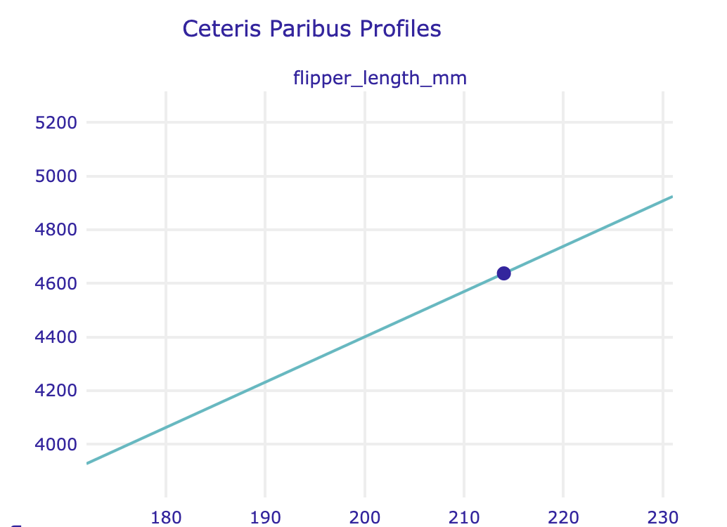
Ceteris Paribus profile
Different plots for different models
Row 231: A Gentoo penguin
Random Forest Regressor
Row 231: A Gentoo penguin
Linear Regression
Notes:
This section should explain ceteris paribus plots and answer the questions from the assignment
Is it the same for every model? Is it the same for every data point?

Slide 58

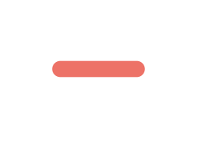
Ceteris Paribus profile
Advantages
Disadvantages
Advantages & disadvantages
Works on a local level for an individual prediction
Displays model’s sensitivity to a feature
Intuitive to understand
(Easy to implement)
Can only display one feature meaningfully at the time
Misleading for correlated features
Only applicable to one data point at the time – does not tell you anything about overall trend
Does not tell you how much a feature contributes to individual prediction
Notes:
LYSANNE NOTE
Images:
Minus: https://thenounproject.com/icon/minus-4696315/
Plus: https://thenounproject.com/icon/plus-4696327/

Slide 59
Jupyter Notebook 3 03_Prediction_Break_Down.ipynb
Notes:
https://ema.drwhy.ai/breakDown.html
The underlying idea of BD plots is to capture the contribution of an explanatory variable to the model’s prediction by computing the shift in the expected value of YY, while fixing the values of other variables.

Slide 60
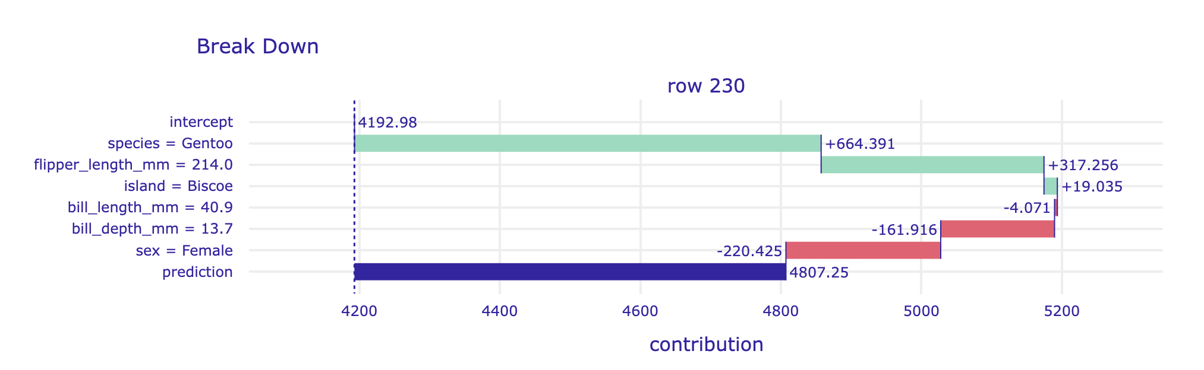
Break-down Plots for Additive Attributions
How to calculate the intercept:
Generate predictions with the model on the train set
Calculate the average prediction on the train set
y_hat = model.predict(X_train)
intercept = y_hat.mean()
Notes:
This section should explain ceteris paribus plots and answer the questions from the assignment
Is it the same for every model? Is it the same for every data point?

Slide 61
Break-down Plots for Additive Attributions
How to calculate the value for species = Gentoo:
Assume that all datapoints in your dataset have the value Gentoo
Calculate the average prediction on the altered (!) train set
Subtract the intercept
X_train[‘species’] = ‘Gentoo’
value = model.predict(X_train).mean()
value - intercept
Notes:
This section should explain ceteris paribus plots and answer the questions from the assignment
Is it the same for every model? Is it the same for every data point?

Slide 62
Break-down Plots for Additive Attributions
How to calculate the intercept:
Generate predictions with the model on the train set y_hat = model.predict(X_train)
Calculate the average prediction on the train set I intercept = y_hat.mean()
How to calculate the value for species = Gentoo:
Assume that all datapoints in your dataset have the value Gentoo X_train[‘species’] = ‘Gentoo’
Calculate the average prediction on the altered (!) train set value1 = model.predict(X_train).mean()
Subtract the intercept gentoo_value = value1 - intercept
How to calculate the value for flipper_length = 214.0:
Assume that all datapoints in your dataset species = Gentoo X_train[‘flipper_length_mm’] = 214.0
and flipper_length = 214.0
Calculate the average prediction on the altered (!) train set value2 = model.predict(X_train).mean()
Subtract the intercept and the value for species = Gentoo flipper_value = value2 - value1 - intercept
Notes:
This section should explain ceteris paribus plots and answer the questions from the assignment
Is it the same for every model? Is it the same for every data point?

Slide 63
Ceteris Paribus profile
Advantages
Disadvantages
Advantages & disadvantages
Works on a local level for an individual prediction
Displays a feature’s importance
Fast to calculate
Visual
The order of the features matters
Misleading for interactions
Messy for many variables
Does not tell you how sensitive a model is to a feature
Only applicable to one data point at the time – does not tell you anything about feature importance
Notes:
Fast: complexity = linear in the number of explanatory variables
An important issue is that BD plots may be misleading for models including interactions. This is because the plots show only the additive attributions. Thus, the choice of the ordering of the explanatory variables that is used in the calculation of the variable-importance measures is important. Also, for models with a large number of variables, BD plots may be complex and include many explanatory variables with small contributions to the instance prediction.
Additive is an assumption
Misleading for interactions
Messy for many variables
Order dependence

Slide 64
Global Feature Importance
Notes:
In this section we shall explain how to import the feature importances of linear regression, decision tree and random forest

Slide 65
Global feature impotances
Linear Regression
Notes:
WE shall start with regression

Slide 66
Linear Regression
m*bill depth + n*flipper length + c = body mass
14*bill depth + 53*flipper length - 6600 = body mass
14*18.7+ 53*181.0 - 6600 = 3171
Notes:
Previously we discussed how it was possible to learn the following linear regression model from the penguins dataset to predict body mass.
With linear regression it is easy to explain our predictions.
For this penguin which has bill depth 18.7 and flipper length of 181, it predicts a body mass of 3171 – a reasonable prediction.
It is also easy to show what would happen if a value was different
- If the bill length were to increase by one the prediction for body mass would increase by 14
- If the flipper length were to increase by one unit (e.g. got from 181 to 182) the prediction for body mass would increase by 53.

Slide 67
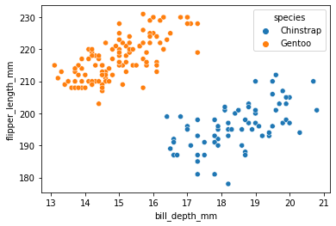
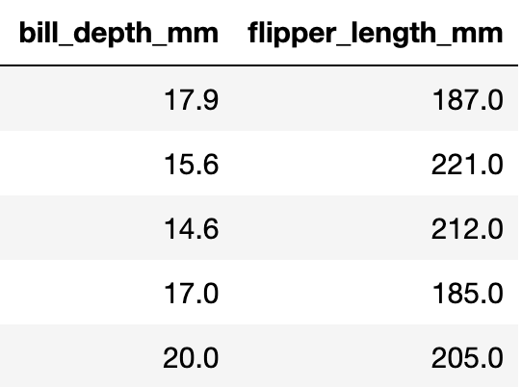
Linear Regression
14*bill depth + 53*flipper length - 6600 = body mass
Notes:
With this model, an increase of 1 in flipper length has a bigger impact on the body mass than an increase of 1 in bill depth.
However, at the moment it would be an unfair to directly compare these coefficients – why?
This is because the scales of the bill depth and flipper length are different. Bill depth ranges from 13.2 to 21.5 mm and flipper length from 172 to 231 mm.
So an increase of 1 for the bill depth is a much more significant change than an increase 1 for the body mass.

Slide 68
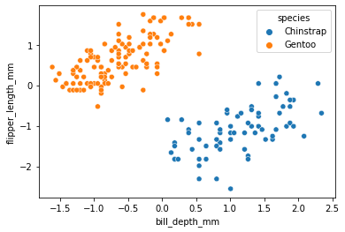
Linear Regression
Notes:
To combat this issue we need to first scale the features to ensure they have a consistent range.
(subtract the mean and scale to unit variance).

Slide 69
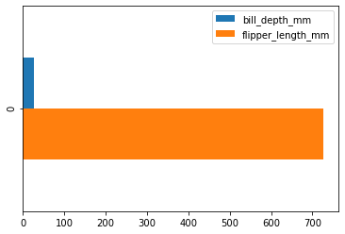
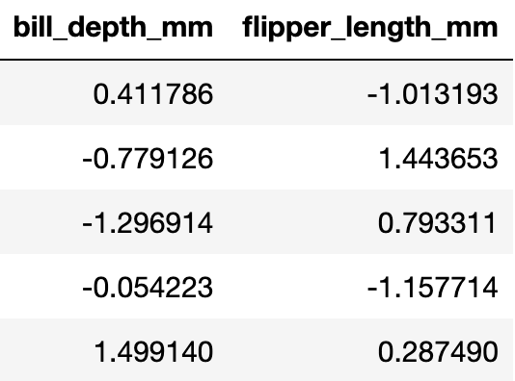
Linear Regression
28*bill depth + 727*flipper length + 4199 = body mass
Notes:
If we scale the penguin dataset beforehand we get the following linear regression model.
Now we can make a fair comparison between the coefficients.
A change in bill depth appears to have much less impact than a proportional change in flipper length.
The model deems flipper length to be a more important feature for determining body mass than bill depth.

Slide 70
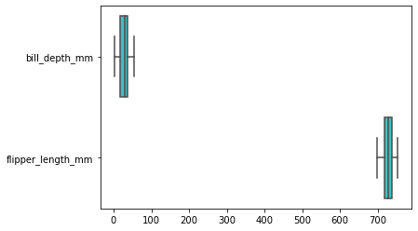
Linear Regression
Notes:
How specific are the feature importances to the specific dataset we trained on.
We can check the coefficient variability by training models on subsamples of the dataset and comparing the coefficients we produce (normally this is done through cross-validation).
If coefficients vary significantly when changing the input dataset their robustness is not guaranteed, and they should probably be interpreted with caution.
https://scikit-learn.org/stable/auto_examples/inspection/plot_linear_model_coefficient_interpretation.html#lessons-learned

Slide 71
Global feature impotances
Decision Tree Classifer
Notes:
Now lets have a look at a classifier

Slide 72
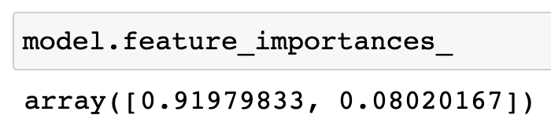
Decision Tree Classifier
Notes:
We previously discussed how Decision Tree classifiers were aimed to reduce impurity metrics such as gini impurity.
For (scikit-learn) decision trees a feature’s importance is calculated by it's total contribution in reducing the impurity.
It is easy to extract the feature importances from a decision tree with scikit-learn.
Without getting too deep into the mathematics, let’s take a closer look as to why this is the case.

Slide 73
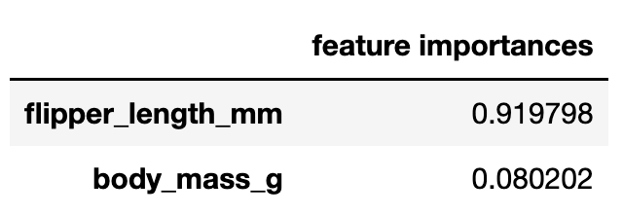
Decision Tree Classifier
Notes:
The decision we take about flipper length results in a large drop in gini impurity for both the left and right branches.
In addition, as this is the root of the tree it affects a lot of datapoints.

Slide 74
Decision Tree Classifier
Notes:
In contrast the decisions about body mass do not reduce impurity as much.
The left node results in an impurity of 0 in its leaves but it was already small beforhand.
For the right node, gini impurity actually increases in the left leaf. However, it should be noted that this only affects 3 datapoints

Slide 75

Global feature impotances
Random Forest Classifer
Notes:
We’ll now look at an extension of the decision tree classifier.
A random forest is an “ensemble” model that consists of multiple decision trees.

Slide 76
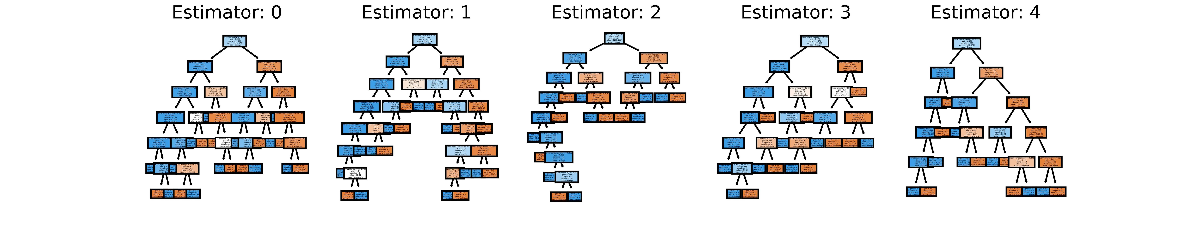
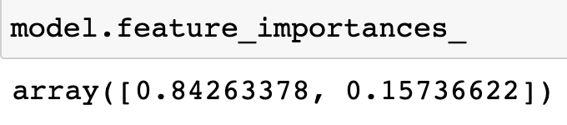
Random Forest Classifier
Notes:
A random forest makes predictions by producing multiple decision trees and asking them to vote on the outcome.
The trees that are learnt from the data are different from one another because they are exposed to different subsets of the data – this stops them being too specific to the nuances of the original dataset .
(This means less variance due to the particular dataset chosen. In addition to this, they do not always consider every feature when they make a decision – which helps avoid overreliance on certain features and overfitting. The trees are also unrestricted so less modelling bias is place – less bias )
Random Forests may have more predictive power than single decision trees, but it comes at a cost to interpretability. There is no longer a singular set of rules that we can use to explain our predictions.
However, it is again easy to extract the feature importances from the model with Scikit-Learn.

Slide 77
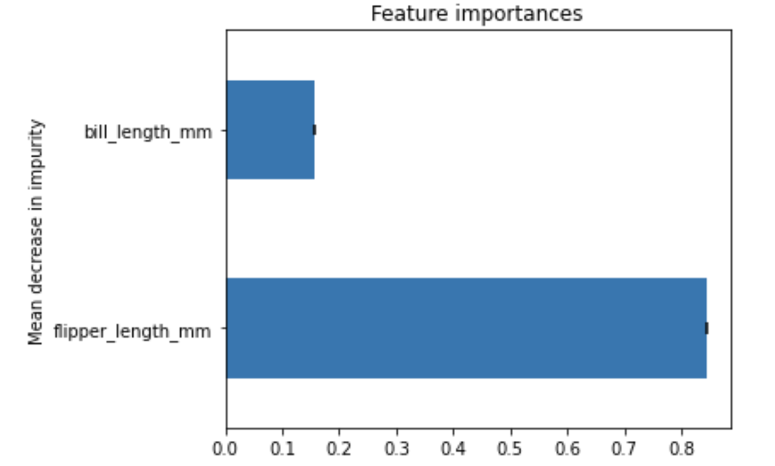
Random Forest Classifier
Notes:
For a random forest, the feature importances are calculated by taking the averages from the trees in the forest.
However, feature importances ccomputed by impurity-based techniques (i.e. the ones used for the decision tree and random forest) can sometimes be misleading, as we will demosntrate in the next section.
https://scikit-learn.org/stable/auto_examples/ensemble/plot_forest_importances.html#feature-importance-based-on-mean-decrease-in-impurity

Slide 78
Jupyter Notebook 4 04_Permutation_Feature_Importance.ipynb

Slide 79
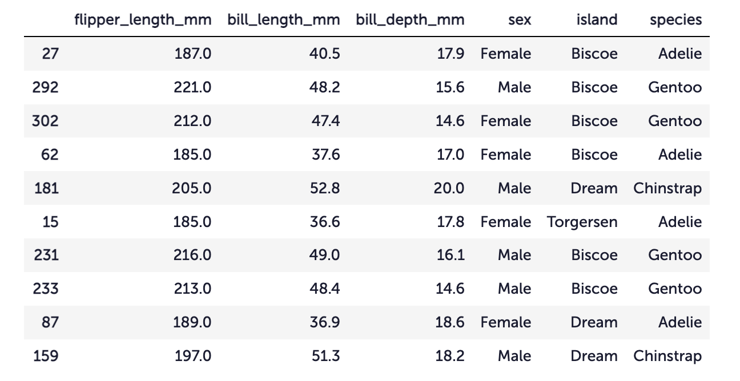
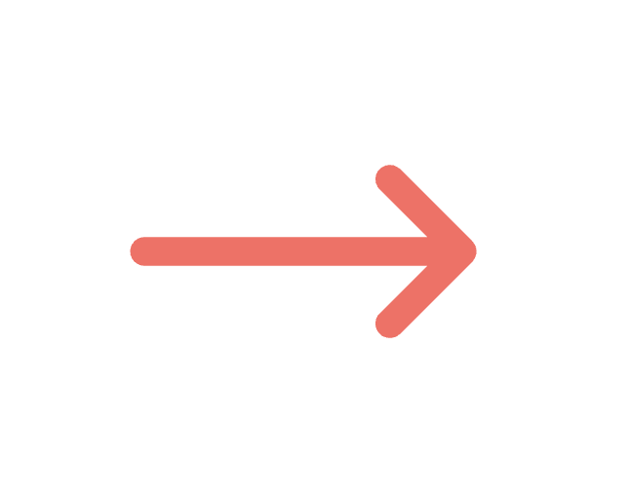
Model-Agnostic Feature Importance
0.856
Notes:
Explain partial dependence plots

Slide 80
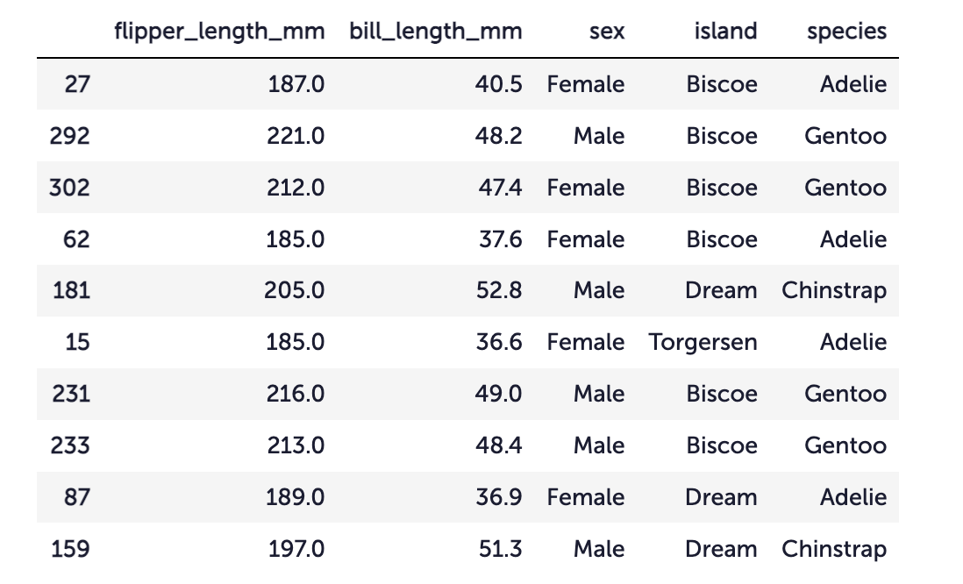
Drop Feature Importance
0.856
???
Notes:
Explain partial dependence plots

Slide 81
Permutation Feature Importance
0.856
???
Notes:
Advanced
* Repeat
* Average
* Standard Deviation
Shuffle Multiple
Explain difference scikit-learn (r2) and dalex (rmse)

Slide 82
Permutation Feature Importance
Advantages
Disadvantages
Advantages & disadvantages
Works on a global level for a model
Displays a feature’s importance
Fast to calculate
Additional tricks
Dependent on randomness
Misleading for correlations
Can lead to unrealistic data points
Need access to true outcome
Does not tell you how sensitive a model is to a feature
Notes:
If features are correlated, the permutation feature importance can be biased by unrealistic data instances. When they are positively correlated (like height and weight of a person) and I shuffle one of the features, I create new instances that are unlikely or even physically impossible (2 meter person weighing 30 kg for example), yet I use these new instances to measure the importance. In other words, for the permutation feature importance of a correlated feature, we consider how much the model performance decreases when we exchange the feature with values we would never observe in reality. Check if the features are strongly correlated and be careful about the interpretation of the feature importance if they are.
You need access to the true outcome. If someone only provides you with the model and unlabeled data – but not the true outcome – you cannot compute the permutation feature importance.
Permutation feature importance is linked to the error of the model. This is not inherently bad, but in some cases not what you need. In some cases, you might prefer to know how much the model’s output varies for a feature without considering what it means for performance. For example, you want to find out how robust your model’s output is when someone manipulates the features. In this case, you would not be interested in how much the model performance decreases when a feature is permuted, but how much of the model’s output variance is explained by each feature. Model variance (explained by the features) and feature importance correlate strongly when the model generalizes well (i.e. it does not overfit).

Slide 83
Jupyter Notebook 5 05_Partial_Dependence_Plots.ipynb

Slide 84
Global Sensitivity

Slide 85
Ceteris Paribus
Sensivity to feature
On a local level
Notes:
Show table local vs global importance vs sensitivity
Advantages & disadvantages of each
Maybe Kahoot here?

Slide 86
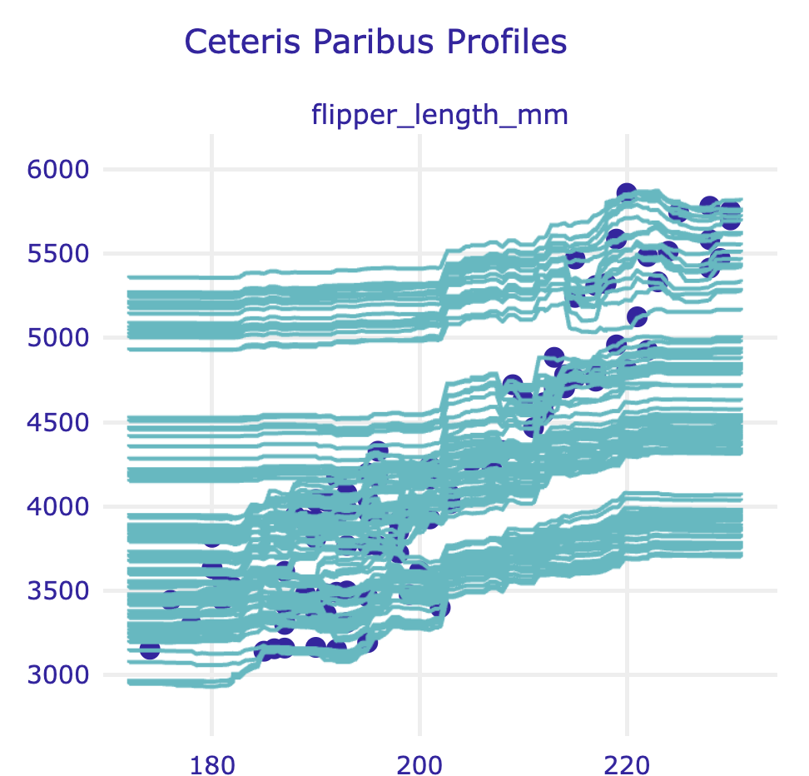
Individual Conditional Expectation
Sensivity to feature
One line per instance
Notes:
Show table local vs global importance vs sensitivity
Advantages & disadvantages of each
Maybe Kahoot here?

Slide 87

Partial Dependence Plot
Sensivity to feature
Average of ICE plot
Global method
Notes:
Show table local vs global importance vs sensitivity
Advantages & disadvantages of each
Maybe Kahoot here?

Slide 88

Partial Dependence Plot
Sensivity to feature
Average of ICE plot
Global method
Notes:
Show table local vs global importance vs sensitivity
Advantages & disadvantages of each
Maybe Kahoot here?

Slide 89
Summary
 | Local | Global
Importance | Break-down plots | Permutation Feature Importance
Sensivitiy | Ceteris Paribus | Partial Dependence Plots
Intrinsicly interpretable machine learning models
Model-agnostic interpretability techniques
Notes:
Show table local vs global importance vs sensitivity
Advantages & disadvantages of each
Maybe Kahoot here?

Slide 90

Hackathon!
Credit Lending
Laptop Prices
Medical Diagnoses
Discussion Hackathon (theory)
Notes:
Show table local vs global importance vs sensitivity
Advantages & disadvantages of each
Maybe Kahoot here?

Slide 91
Unpacking the Black Box
How to Interpret your Machine Learning Model

Slide 92
Workshop Summary
Introduction to Time Series Analysis
Seasonality Modelling
Timestamps
Time-based aggregations
Creating time-based features
Smoothing Time Series data
Time Series decomposition
Modelling Time Series data
Engineering seasonal features
Outlier/anomaly detction
Model evaluation
Notes:
Summarise what we’ve covered

Slide 93
GoDataDriven
The Data & AI Maturity Journey
13:30-17:30, March 28 @ 1A
@ AMLD Switzerland 2022
Notes:
Take this opportunity to advertise our other talks

Slide 94

GoDataDriven Academy
Public trainings
In-company tailored trainings
Virtual & in-person
Visit godatadriven.academy
Notes:
We’re Data Science Educators!

Slide 95
Unpacking the Black Box
How to Interpret your Machine Learning Model

